Slide 1
Struggling in Silence
ASIAN AMERICAN MENTAL HEALTH
Jenn | Reappropriate.co

Slide 2
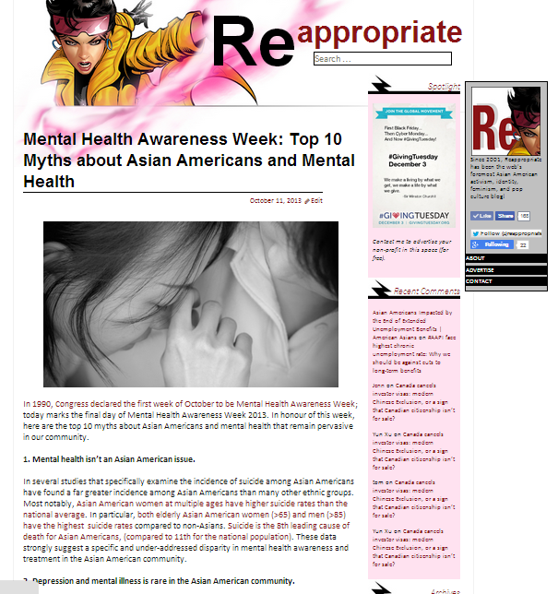
Ph.D. in Physiological Sciences
B.A. in Biology Minor in Asian American Studies
Reappropriate (2002-now)
The web’s first Asian American identity / feminism blog
reappropriate.co @Reappropriate

Slide 3
21 student suicides at Cornell between 1996-2006.
?
How many were Asian American?
15%
30%
55%
ANSWER:
13 of the 21 student suicides at Cornell between 1996-2006 were committed by Asian American students.
SOURCE: Asian/Asian American Task Force Report

Slide 4
Depression on Campus
1 in 3 college-aged students report depression or related symptoms.¹
RISK OF SUBSTANCE ABUSE
On-campus depression if left untreated can increase risk of drug / alcohol abuse.²
RISK OF SUICIDE³
15% of college-aged students report thinking about suicide at one point.
7 out of 100,000 die by suicide annually.
Suicide is the second leading cause of death for college-aged people.
Results of AHCA-NHCA Survey
Weitzman 2004
Adapted from Suicide Prevention Center

Slide 5
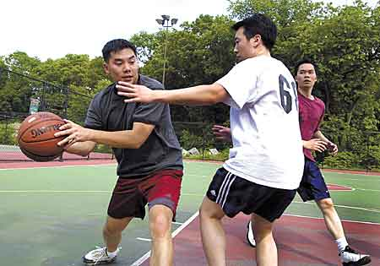
What is Depression?
HEALTHY
Mild fluctuations in mood (happiness or sadness) in response to stimuli that resolve on their own with time.
Bipolar Disorder
COMMON MOOD DISORDERS
Depression (Major Depressive Disorder)
Frequent, extreme feelings of malaise that don’t resolve over time, and may even get progressively worse.
Bipolar Disorder (BPD)
Extreme, uncontrolled fluctuations between depressive episodes and episodes of euphoria or “mania”.
STRESSOR
MOOD
Healthy
STIMULUS
Clinical Depression

Slide 6
Symptoms of Depression?
Feelings of helplessness/hopelessness
Loss of interest in daily activities
Loss of attention or interest in appearance or hygeine
Social withdrawal
Unexplained change in appetite or weight
Unexplained change in sleep patterns
Unexplained attention problems
Anger/irritability
Fatigue or sluggishness
Self-loathing
Reckless behaviour
Self-harm and/or thoughts of suicide
Unexplained aches, pains or cramps
SMALL GROUPS: Make a list of some common warning signs and symptoms of depression.
Adapted from art by Sylvie Reuter (SylvieReuter.de)
Adapted from the National Institutes of Mental Health

Slide 7
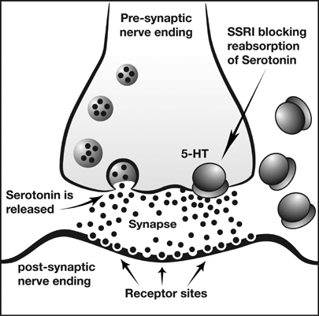
Possible Causes of Clinical Depression
STRESSOR
Frequent or higher stress may trigger depression and/or a depressive episode.
BIOLOGY
Major
Depression
A biological predisposition for clinical depression.
LACK OF HELP
Early diagnoses and treatment can significantly combat symptoms of depression.

Slide 8
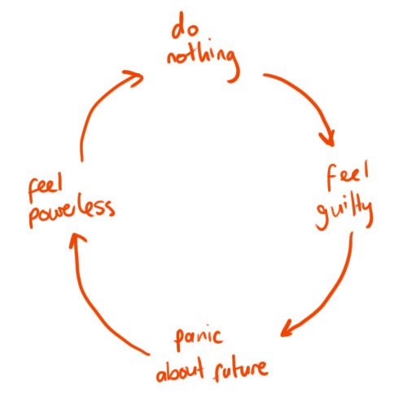
The Self-Perpetuating Cycle of Depression
Combination of anti-depressants and counseling can be highly effective in treating symptoms of depression.
Many symptoms of depression – apathy, powerlessness, guilt – actually discourage treatment.
via Reddit

Slide 9
Untreated Depression & Suicide
Depression – if left untreated – can significantly increase risk of suicide:
Most on-campus suicides involve patients not actively receiving mental health treatment.¹
Groups at highest risk for suicide:²
Males
Aged 15-24, or 65+
Source: SPRE
Source: National Institutes of Health

Slide 10
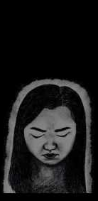
Depression in the Asian American Community
Asian American students are more likely than White peers to report depression symptoms.¹
US-born Asian Americans are ~3x more likely to report depression than foreign-born Asian Americans.²
Adapted from artwork found at Capital Goods capitalgoods.wordpress.com
Kitsch et al 2005
Reviewed in Kalobatseva and Leong 2011

Slide 11
Suicide in the Asian American Community
Asian American women have the highest rate of suicide vs. women of all races – at almost all age groups.¹
Asian American men aged 25-34 or 85+ have the highest rate of suicide vs. same-aged men of other races.²
Suicide is the 8th leading cause of death for Asian Americans (vs. 10th for non-Asians).²
Research of Dr. Eliza Noh, UC Berkeley
Source: National Institutes of Mental Health

Slide 12
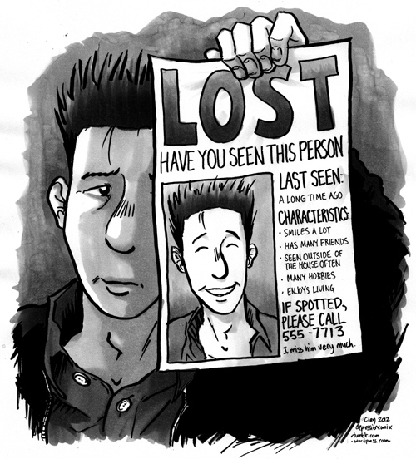
SMALL GROUPS: Why do you think depression/suicide higher among Asian Americans?
Art by Depression Comix (depressioncomix.tumblr.com)
SOME POSSIBILITIES:
High pressure to succeed?
Model Minority Myth (stereotype promise)?
Cultural stigmas?
Lack of culturally-specific and/or Asian language treatments options?

Slide 13
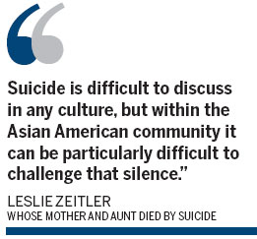
The Impact of Stigma
Stigmas over mental illness can lead to:
Ignorance / embarrassment of the symptoms
Feelings of isolation that exacerbate symptoms
Reluctance to seek help
Asian Americans are 50% less likely to report symptoms of depression to others.
13%
Asian Americans are 7x less likely to report symptoms to a doctor.
2%
Non-AAPI
AAPI
From AASPE.net

Slide 14
As a STUDENT ACTIVIST: What Can You Do?
‘
‘
Start the conversation:
Build a supportive community:
Improve mental health resources:
We can start by acknowledging and engaging in dialogue about the pervasive issue of depression and suicide in the APA community.
Organize workshops to RAISE AWARENESS about Asian American mental health, depression, and suicide – both on-campus and off-campus – as well as available resources.
CAPITAL GOODS
capitalgoods.wordpress.com
Create an Asian American community & SUPPORT NETWORK – this helps identify students who may be struggling with depression, which can facilitate early diagnosis and treatment.
Work with on-campus and off-campus health administrators IMPROVE MENTAL HEALTH RESOURCES for Asian Americans.

Slide 15
3ATF at Cornell University
Identified high rate of on-campus Asian American depression/suicide.
Recommended:
Increased education of mental health resources to incoming students.
Improved culturally-specific mental health resources for Asian American students.
Formation of A3C community centre – which was established in 2008!
All direct results of years of STUDENT ACTIVISM!

Slide 16
As a FRIEND or SUFFERER: What Can You Do?
TALK
CHECK
EMERGENCY
START A CONVERSATION with friends and family. If you are a worried about a friend, talk to them and listen to them – be patient and persistent, not pushy or judgemental.
GET HELP by making an appointment with a mental health professional. If you are worried about a friend, let them know about available resources and offer to accompany them when they get help.
IF YOU THINK YOU OR A FRIEND ARE IN IMMINENT DANGER: call 911 and do not let the person in trouble be alone.

Slide 17
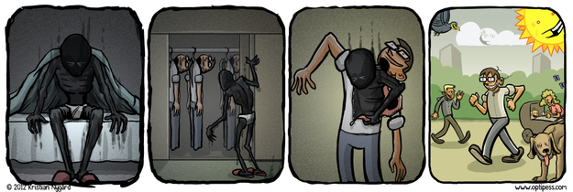
A FEW DON’Ts:
DON’T ignore possible signs or symptoms in yourself or others.
DON’T feel ashamed or guilty for your depression.
DON’T tell a friend who may be depressed to just “get over it” – they probably can’t by themselves.
DON’T stop your anti-depressant treatments without consulting your doctor, even if you “feel better”.
Art by Kristian Nygἀrd

Slide 18
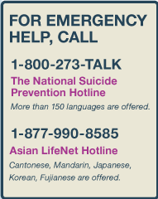
MENTAL HEALTH RESOURCES
Asian American Suicide Prevention & Education AASPE.net
National Asian American Pacific Islander Mental Health Association NAAPIMHA.org
American Foundation for Suicide Prevention ASFP.org
ASIAN AMERICAN HEALTH RESOURCES
Asian & Pacific Islander Health Forum APIAHF.org
Asian & Pacific Islander Wellness Center APIAwellness.org
CONTACT JENN
Reappropriate.co @Reappropriate
From AASPE

